Slide 1
Brief view
of Proline
BI062
Zhiwen Qiang
515030910367

Slide 2
Properties
Uses
Functions in organism
CONCENTS

Slide 3
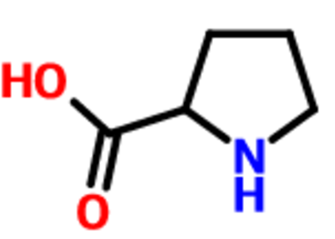
properties
Properties
Chemical formula | C₅H₉NO₂
Molar mass | 115.13 g·mol⁻¹
Appearance | Transparent crystals
Melting point | 205 to 228 °C (401 to 442 °F; 478 to 501 K) (decomposes)
Solubility | 1.5g/100g ethanol 19 degC^{[2]}
log P | -0.06
Acidity (pK_{a}) | 1.99 (carboxyl), 10.96 (amino)^{[3]}

Slide 4
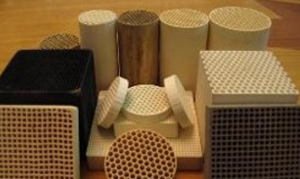
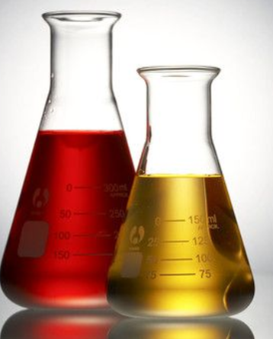

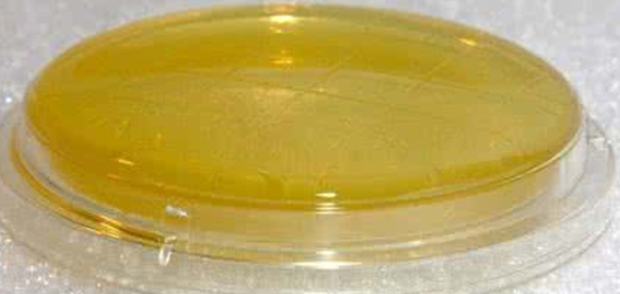
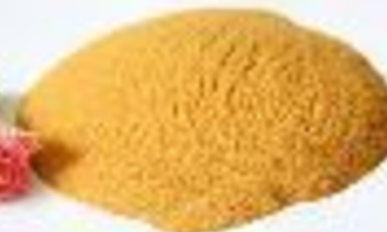
Uses
asymmetric catalysts
produce haze
osmoprotectant
growth medium
bioflavours

Slide 5
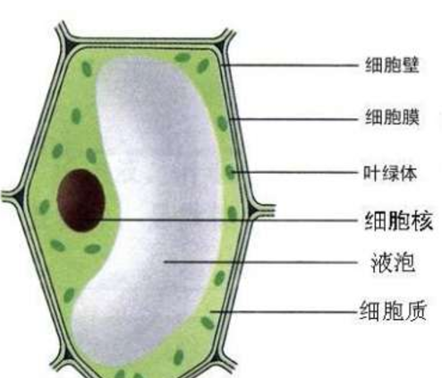
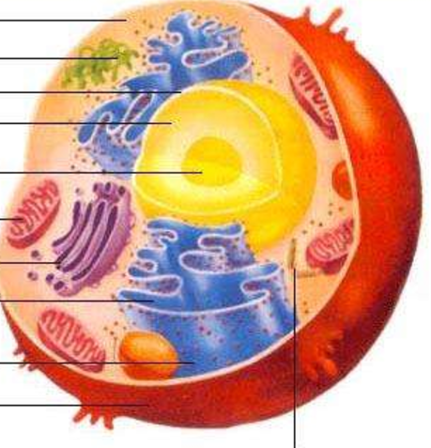
Functions in organism
Proline is one of the basic components of the plant protein and it is revelent with the formation of cytoderm.
it can stable biological macromolecule structure and prevent cell dehydration.
Proline is the ideal tool to adjust Osmotic pressure.
It can also use to protect enzyme and membrane.

Slide 6
THANK YOU

